Slide 1
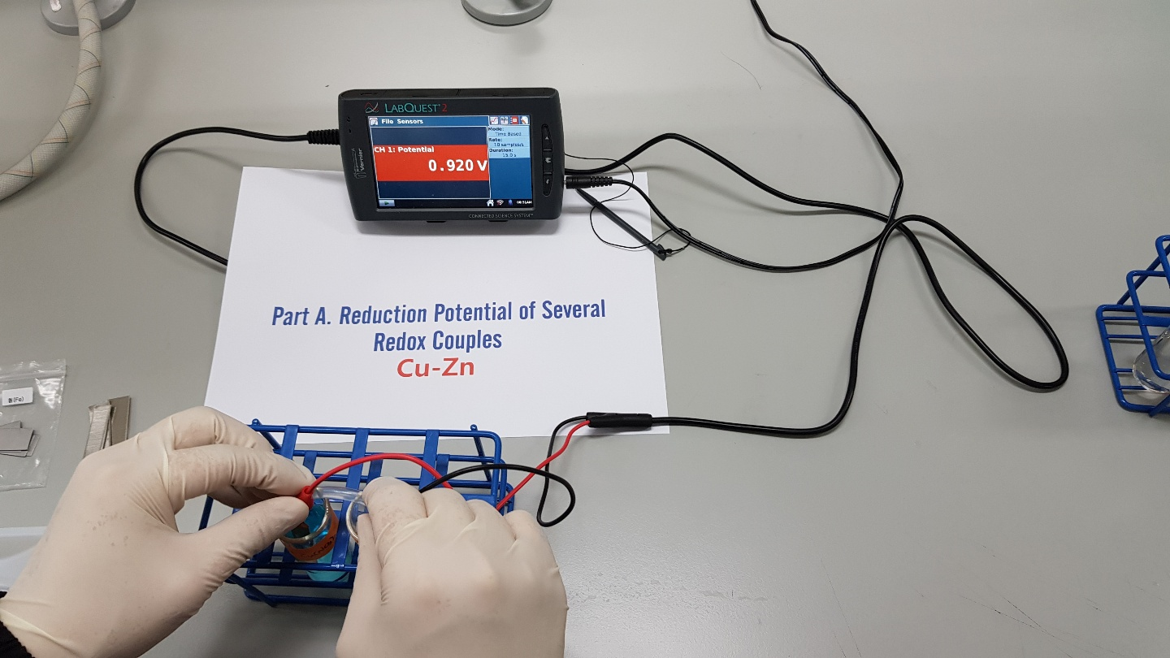
PART A

Slide 2
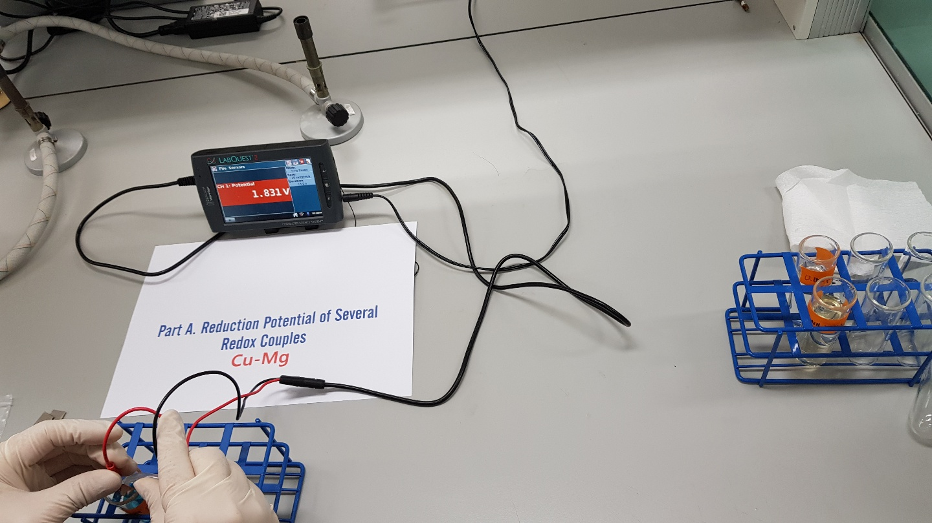

Slide 3
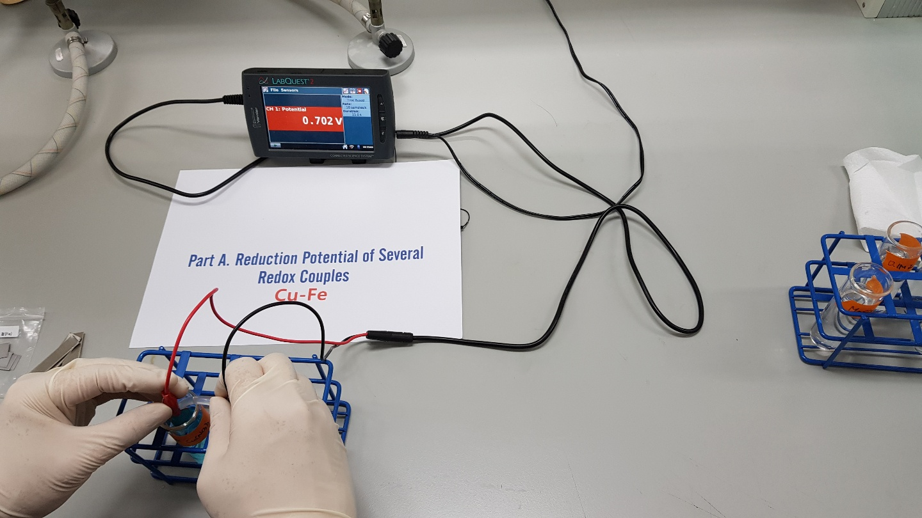

Slide 4
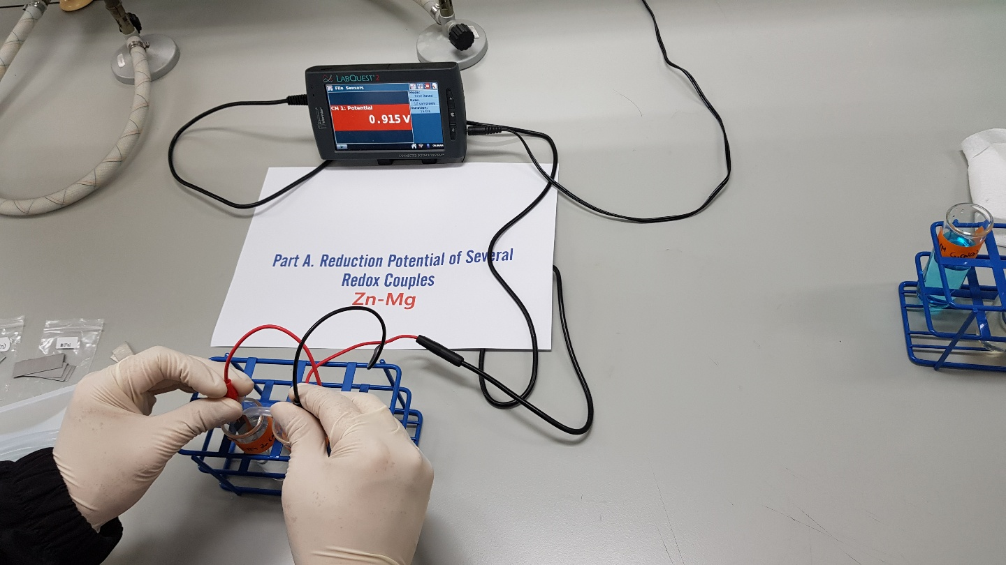

Slide 5
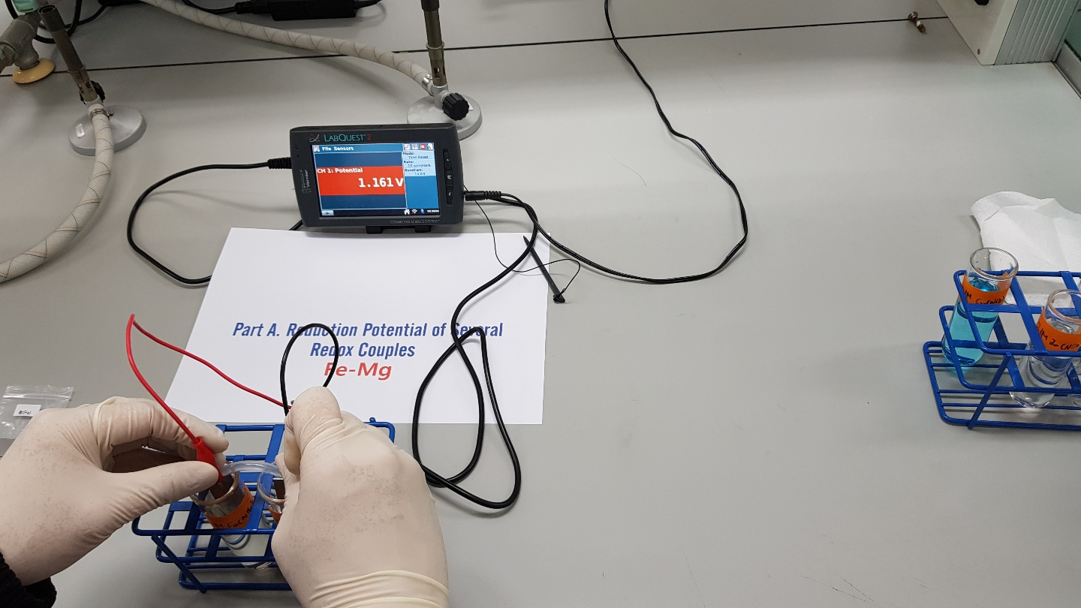

Slide 6
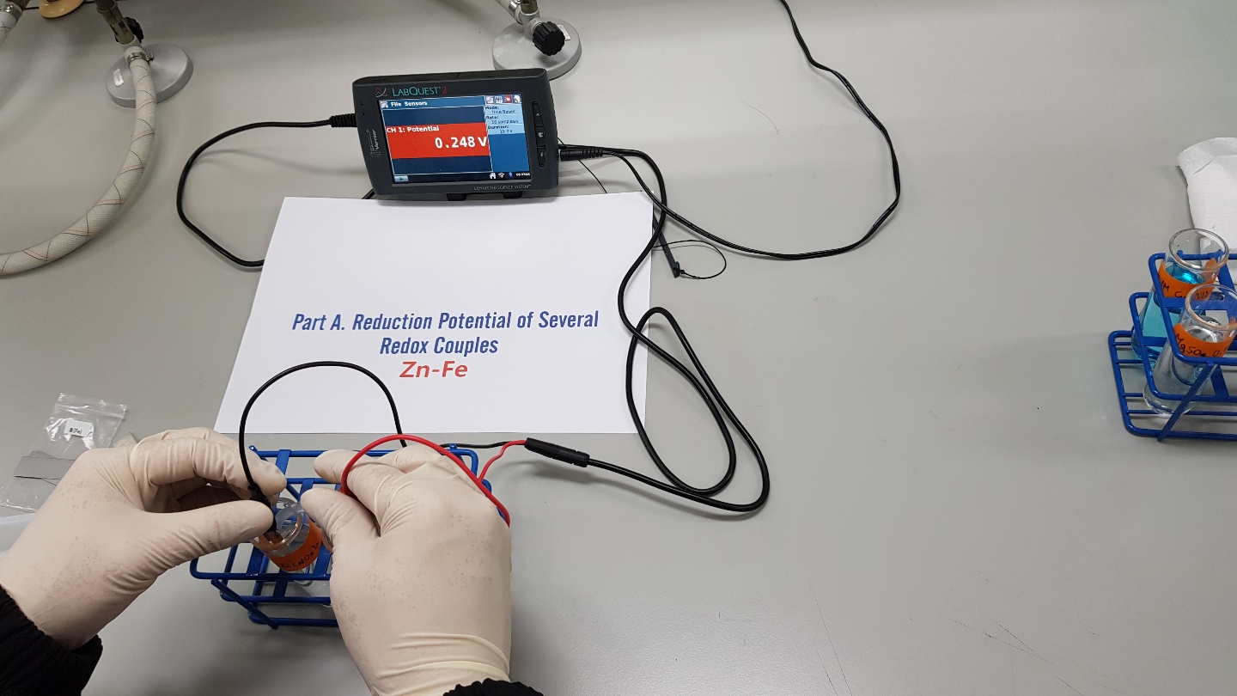

Slide 7
PART A Summary
Galvanic Cell | E_{cell} Measured( V )
Cu-Zn | 0.920
Cu-Mg | 1.831
Cu-Fe | 0.702
Zn-Mg | 0.915
Fe-Mg | 1.161
Zn-Fe | 0.248

Slide 8
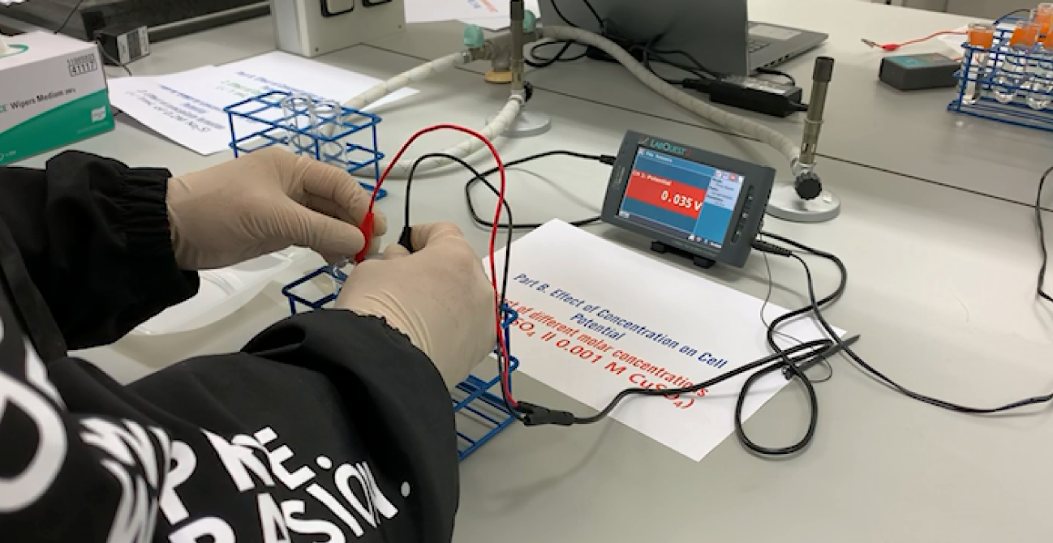
PART B.1

Slide 9
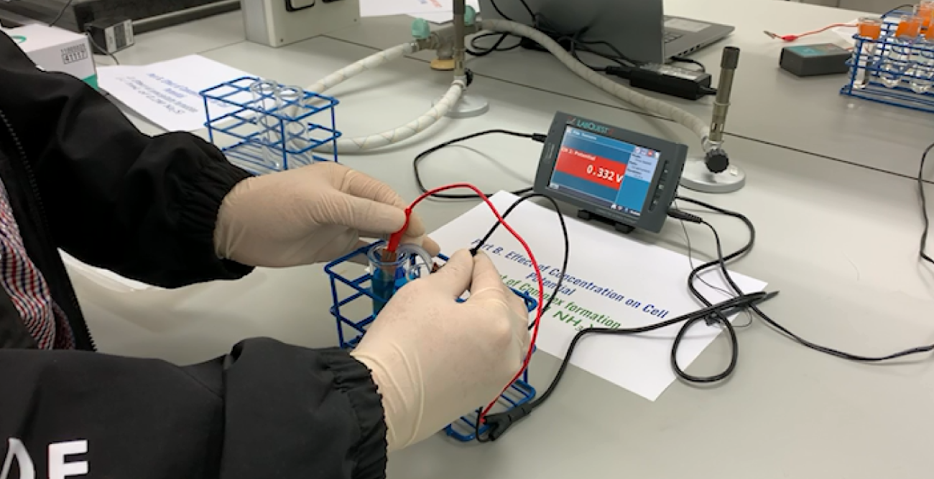
PART B.2

Slide 10
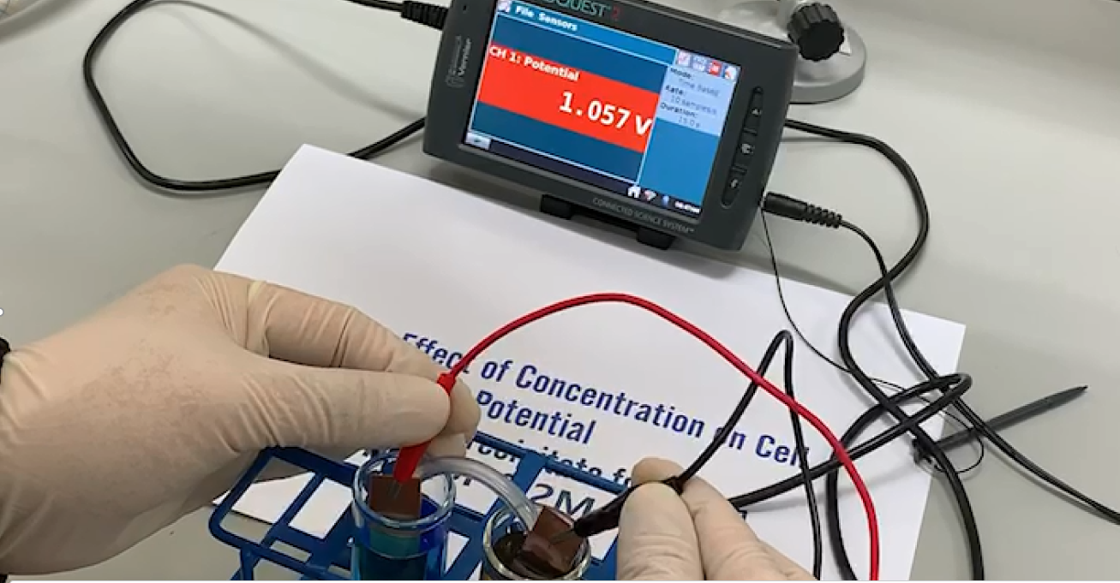
PART B.3
You should watch video for detail observation

Slide 11
PART C Summary
Solution Number | Concentration of Cu(NO₃)₂ | E_{cell} (Experimental) | -log[Cu ²⁺] (pCu)
1 | 0.1 mol/L | 0.93 | 1
2 |  | 0.86
3 |  | 0.79
4 |  | 0.78
5 (unknown concentration) |  | 0.82

